Slide 1
Spring Private Marina All Member Meeting
April 1, 2023

Slide 2
Agenda
Welcome – Introductions
Lake Levels
  Predictions
  Dock Layouts
Financials
  2022 Expenses Closeout
  Increase Annual Maintenance Fee
  2023 Budget – Expenses LE
Members Comments
Closing remarks

Slide 3
Introduction
Bob Busick – Member
Craig Stolz - Member
Ivan Wheeler – Member
Randy Gillenwater – Member/Boards Liaison
Hollie - Smith Construction – Service Contractor
Mike Everett – Lead

Slide 4
Lake Levels

Slide 5
Lake Level 100% to 92%
800’ to 794’
All Docks Are Floating And Can Be Used!
M – A – B – C – E - D
C
M
A
B
E
D
Turkey Cove Upper Parking Lot
Connected to Upper Stairs on Turkey Cove

Slide 6
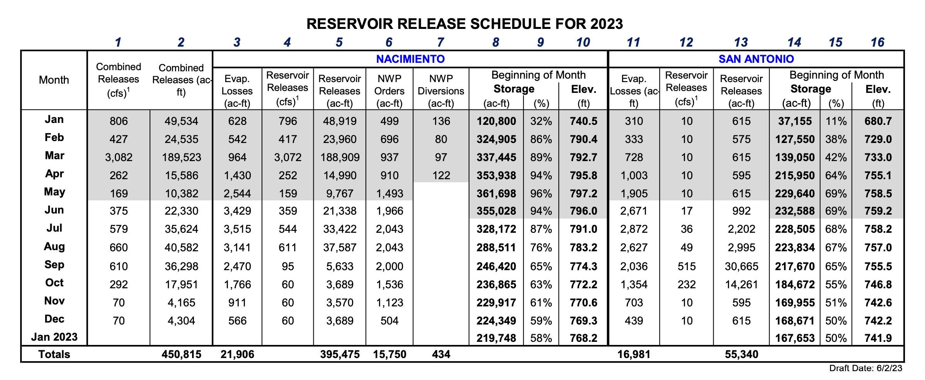
2023 Release Schedule
Notes:
1. Mean daily flow for the month in cubic feet per second. 417,121
2. Shaded areas denote actual values. Non-shaded areas are projected values.
3. Nacimiento Reservoir storage capacity: 377,900 acre feet; San Antonio Reservoir storage capacity: 335,000 acre feet. 4. Proposed schedule meets Agency annual water withdrawal limits required by State Water Board appropriative water rights for the Nacimiento and San Antonio Rivers. 5. Reservoir Operations Advisory Committee may make release considerations for fish spawn and holiday periods to benefit recreation. 6. Schedule assumes no inflow to reservoirs after May 1st. Elevations will be influenced by actual inflow amounts.
7. "NWP Diversions" are San Luis Obispo County - Nacimiento Water Project conveyance facilities diversions. Max. allowable water year (Oct. 1 - Sept. 30) diversions: 15,750 ac-ft. 8. Nacimiento "NWP Diversions" do not include lakeside water use which is estimated at approximately 1,750 acre feet per year.
RESERVOIR RELEASE SCHEDULE FOR 2023

Slide 7
Current Lake Status
ALL Docks are floating!
2022 - parts of E and C & D only floated
Lake Low 2022 December 1st – 16%, 715.70 - All Docks were nest
End of the 2022 - December 31st – 27%, 734.40.50
Lake is at 93%, 795.55’ (3-31-23)
  Lake San Antonio is at 64%, first time that high in years!
Lake levels during the summer months dropped 6 to 8 feet drop per month (Typically Starting in April/May)
Dock predictions, using the 1st of each month (Draft Release Schedule for 2023 not yep posted)
  May - 86% - 792’ – All Docks Floating
  June - 83% - 788’ – All Docks Floating
  July – 75% - 782’ – All Docks Floating
  August – 68% - 776’ – All Docks Floating
  September – 60% - 770’ – All docks Floating
  October – 54% - 764’ – All docks Floating
  November – 50% - 760’ – All docks Floating
  December – 46% - 758’ – All docks Floating
Old Data
Numbers are the 1st of each month

Slide 8
Dock Layouts

Slide 9
Lake Level 100% to 92%
800’ to 794’
M – A – B – C – E - D
C
M
A
B
E
D
Turkey Cove Upper Parking Lot
April/July
Connected to Upper Stairs on Turkey Cove

Slide 10
Lake Level 91% to 84%
794’ to 788’
M – A – B – C – E - D
C
M
A
B
E
D
Turkey Cove Upper Parking Lot
Caution: Parking lot is submerged. Will be marked
July/August

Slide 11

Lake Level 83% to 71%
788’ to 779’
M - A – B C - E - D
D
M
A
B
E
Turkey Cove Upper Parking Lot
C
August - October

Slide 12
Lake Level 70% to 60%
778’ to 769’
M – A – B C - D
D
M
A
B
C
E
Turkey Cove Upper Parking Lot
E
Nov

Slide 13
Lake Level 60% to 40%
769’ to 750’
M – A – B C D
C
D
M
A
B
E
Turkey Cove Upper Parking Lot
E

Slide 14
Lake Level 39% to 29%
749’ to 736’
M, A, B C D
D
M
A
B
C
Turkey Cove Upper Parking Lot
E
E

Slide 15
Lake Level 29% to 28%
736’ to 735’
M, A, B C D
D
A
B
C
M
Turkey Cove Upper Parking Lot
E
E
M Dock Nested

Slide 16
Lake Level 28% to 28%
735’ to 734’
M, A, B C D
D
B
C
M
A
Turkey Cove Upper Parking Lot
E
E
M & A Docks Nested

Slide 17
Lake Level 27% to 27%
733’ to 732’
M, A, B C D
D
C
M
A
B
Turkey Cove Upper Parking Lot
E
E
M, A & B Docks Nested

Slide 18
Lake Level 26% to 18%
732’ to 719’
M, A, B C D
D
C
M
A
B
Turkey Cove Upper Parking Lot
E
E
M, A, B & E Docks Nested

Slide 19
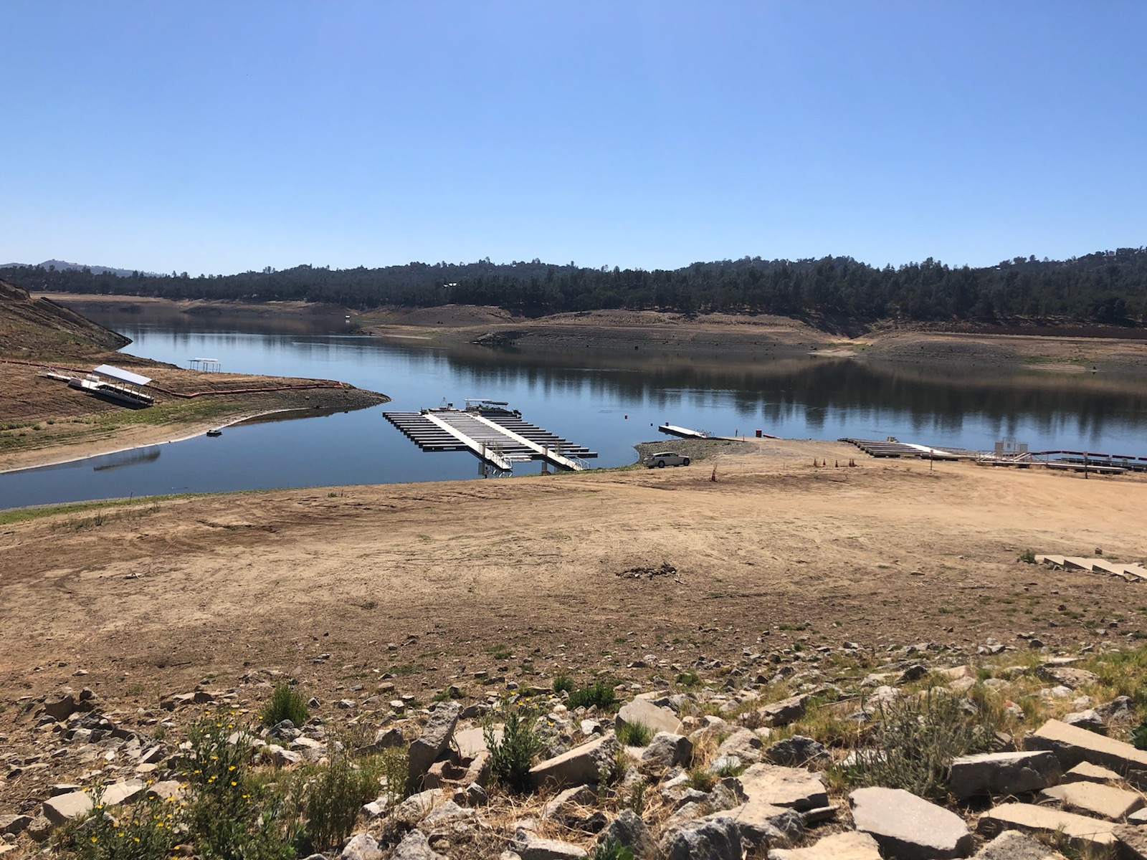
Lake Level 17% to 17%
717’ to 714’
M, A, B C D
C
D
October 2022
M
A
B
Turkey Cove Upper Parking Lot
E
E
M, A, B, C & E Docks Nested

Slide 20
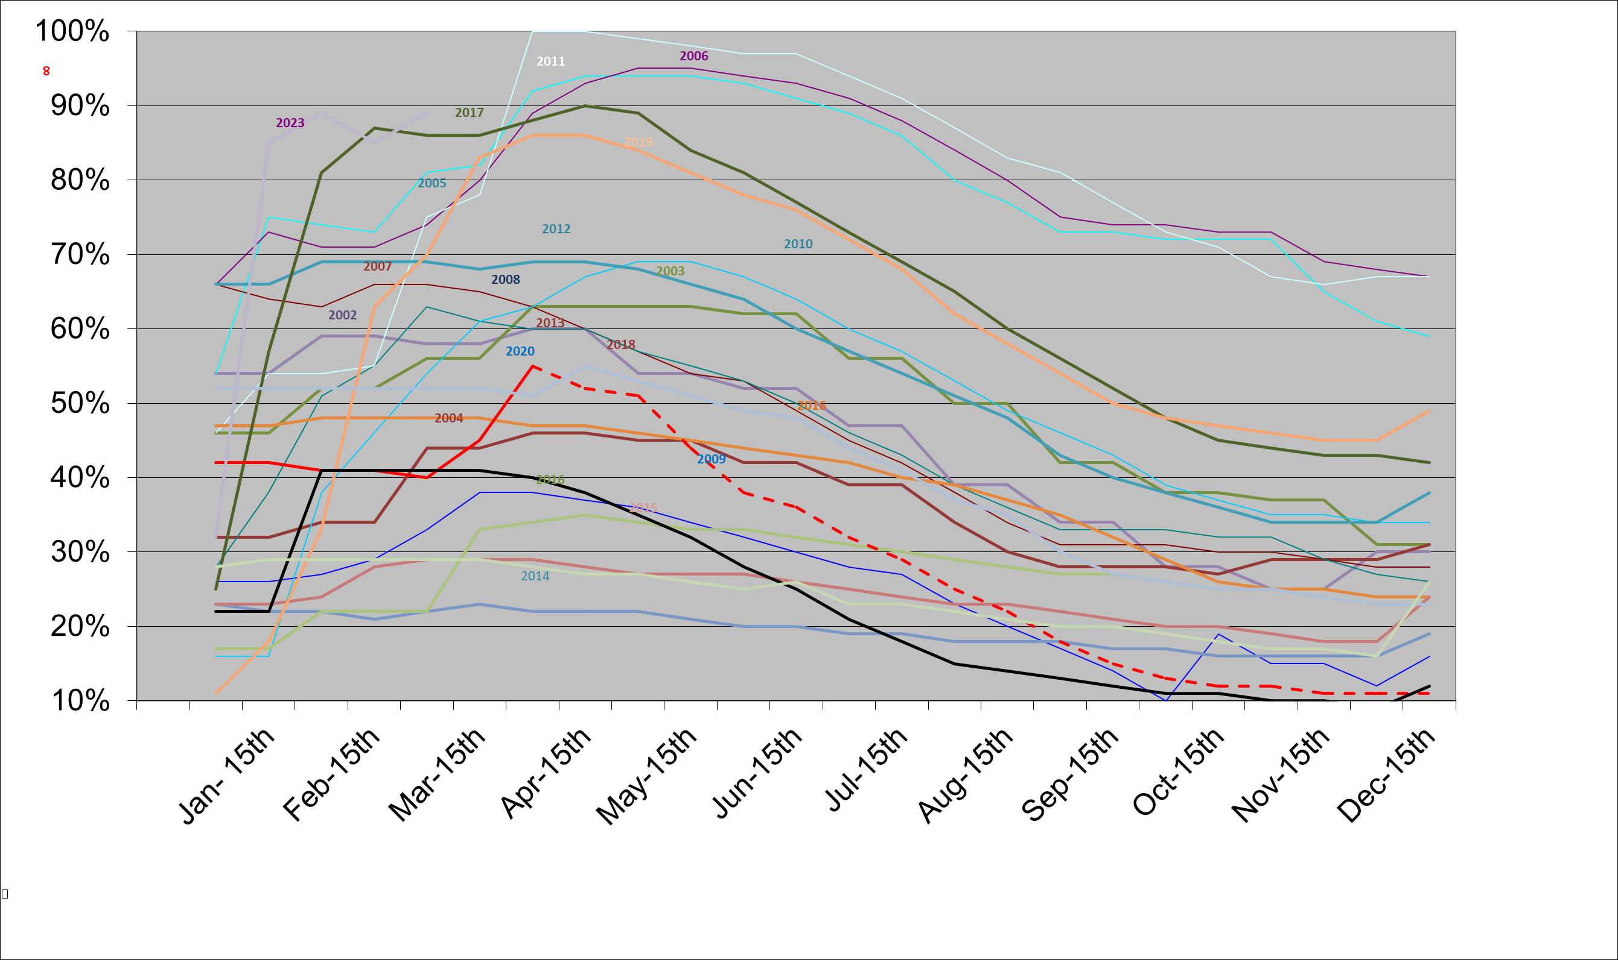
21 Years of Lake Level History
2022

Slide 21
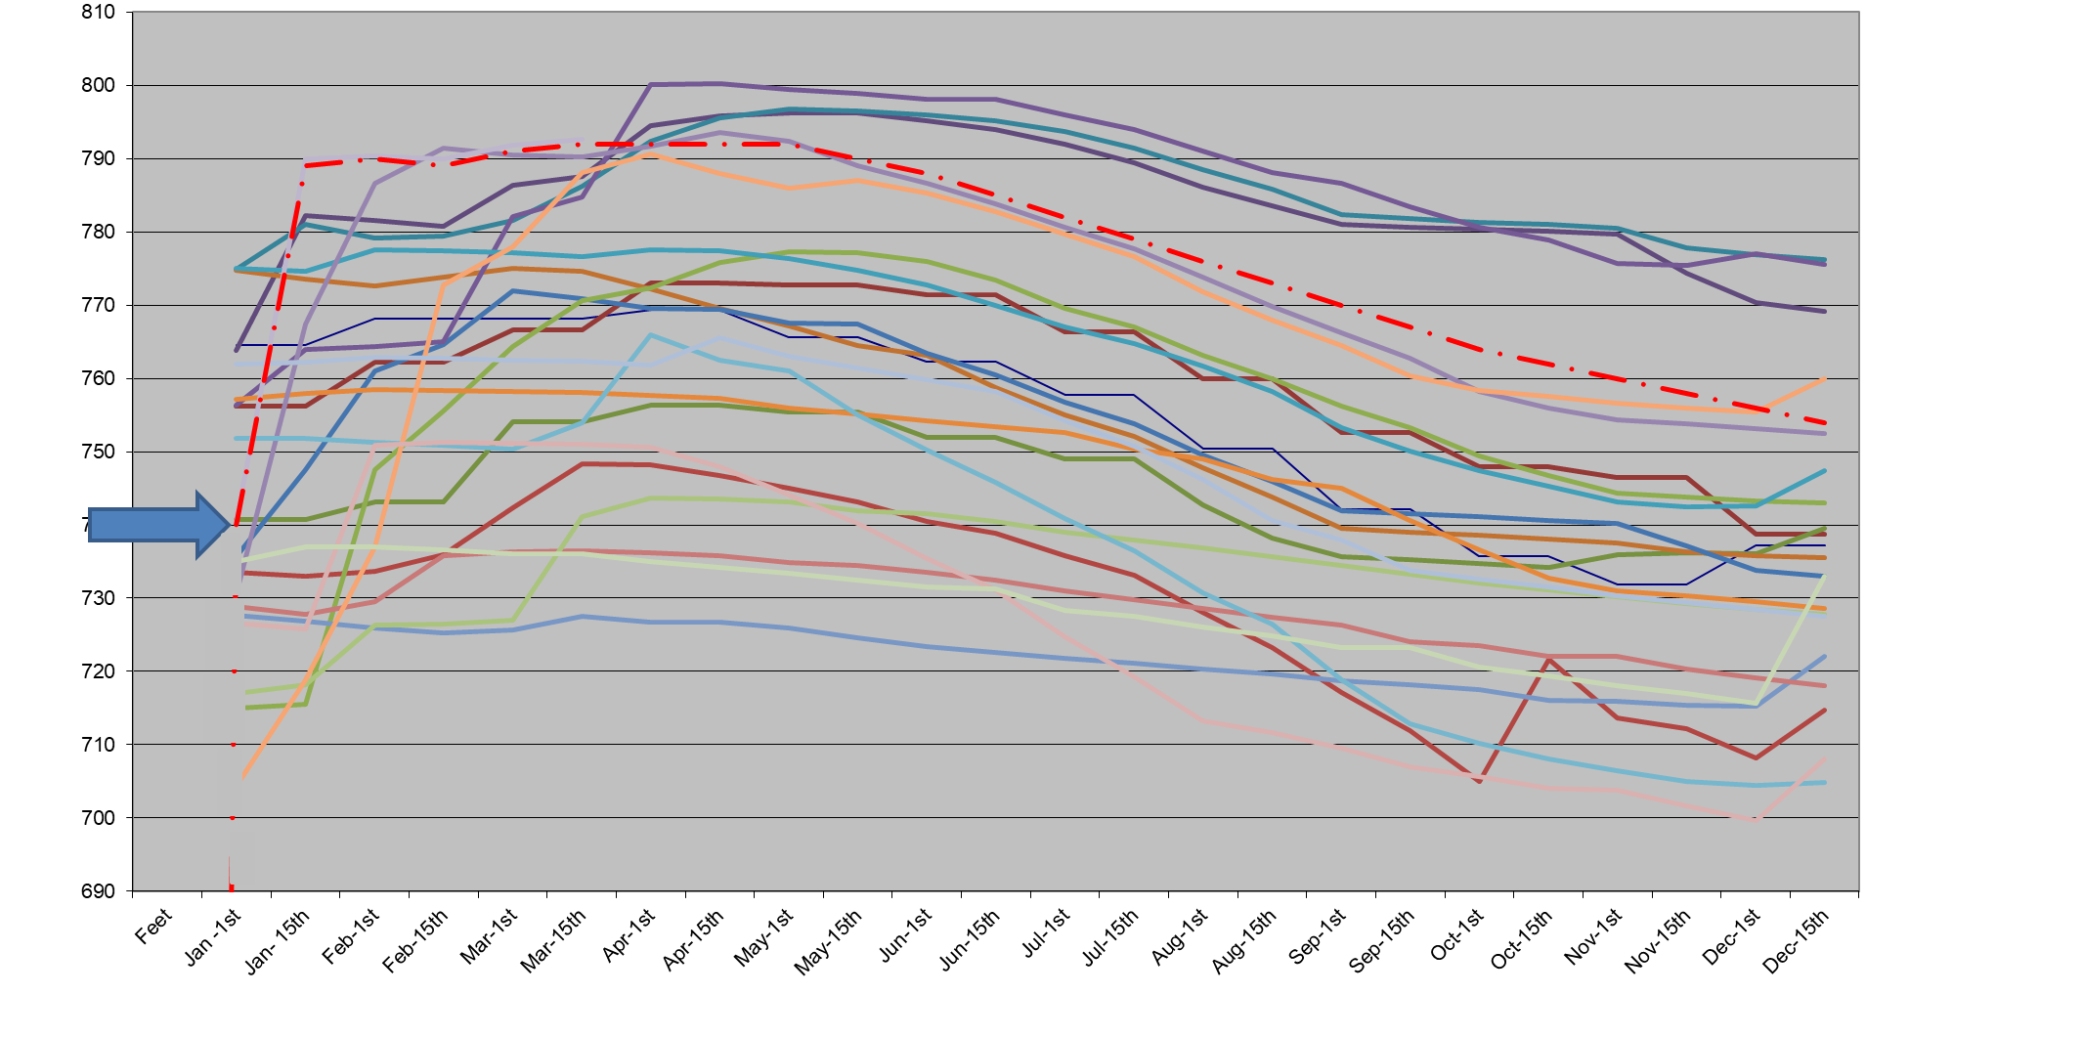
20 Years of Lake Level History
2023 Lake Level Predictions

Slide 23
 | Num | Percentage | Feet | Docks | Ramp | Comments |  | Num | Percentage | Feet | Docks | Ramp | Comments |  | Num | Percentage | Feet | Docks | Ramp | Comments |  | Num | Percentage | Feet | Docks | Ramp | Comments
 | 1 | 100% | 800 | HW - C,M,A,B,E,D | -17 | Turkey Cove |  | 26 | 75% | 782.05 | M,A,B - C,E,D | 375 |  |  | 51 | 50% | 760 | M,A,B - C - D - E | 250 |  |  | 76 | 25% | 731 | C - D, Nest - M - A - B - E | 50
 | 2 | 99% | 799.45 | HW - C,M,A,B,E,D | -16 |  |  | 27 | 74% | 781.85 | M,A,B - C,E,D |  |  |  | 52 | 49% | 758.8 | M,A,B - C - D - E |  |  |  | 77 | 24% | 729.9 | C - D, Nest - M - A - B - E | 25
 | 3 | 98% | 798.1 | HW - C,M,A,B,E,D | -15 |  |  | 28 | 73% | 780.6 | ,M,A,B - C,E,D |  |  |  | 53 | 48% | 758.15 | M,A,B - C - D - E | 225 |  |  | 78 | 23% | 727.5 | C - D, Nest - M - A - B - E | 15
 | 4 | 97% | 798.1 | HW - C,M,A,B,E,D | -14 |  |  | 29 | 72% | 779.7 | M,A,B - C,E,D |  |  |  | 54 | 47% | 757.1 | M,A,B - C- D - E |  |  |  | 79 | 22% | 725.7 | C - D, Nest - M - A - B - E | 0
 | 5 | 96% | 797 | HW - C,M,A,B,E,D | -13 |  |  | 30 | 71% | 778.9 | M,A,B - C,E,D |  |  |  | 55 | 46% | 756 | M,A,B - C - D - E |  |  |  | 80 | 21% | 724.55 | C - D, Nest - M - A - B - E | Aux
 | 6 | 95% | 796.8 | HW - C,M,A,B,E,D | -12 |  |  | 31 | 70% | 777.9 | M,A,B - C,D - E |  |  |  | 56 | 45% | 755.08 | M,A,B - C - D - E |  |  |  | 81 | 20% | 723.4 | C - D, Nest - M - A - B - E
 | 7 | 94% | 796 | HW - C,M,A,B,E,D | -11 | West Ramp |  | 32 | 69% | 777.1 | M,A,B - C,D - E | 350 |  |  | 57 | 44% | 754.2 | M,A,B - C - D - E |  |  |  | 82 | 19% | 721.8 | C - D, Nest - M - A - B - E
 | 8 | 93% | 795.15 | HW - C,M,A,B,E,D | 10 |  |  | 33 | 68% | 774.7 | M,A,B - C,D - E |  |  |  | 58 | 43% | 753.35 | M,A,B - C - D - E | 200 |  |  | 83 | 18% | 719.15 | C - D, Nest - M - A - B - E
 | 9 | 92% | 794.8 | HW - C,M,A,B,E,D | -9 |  |  | 34 | 67% | 772.3 | M,A,B - C,D - E |  |  |  | 59 | 42% | 752.65 | M,A,B - C - D - E |  |  |  | 84 | 17% | 717.15 | D, Nest M - A - B - C - E
 | 10 | 91% | 794 | UP- M,A,B,C - E,D | -8 |  |  | 35 | 66% | 774.7 | M,A,B - C,D - E |  |  |  | 60 | 41% | 751.6 | M,A,B - C - D - E |  |  |  | 85 | 16% | 714.7 | Nest M - A - B - C - D - E
 | 11 | 90% | 793.5 | UP - M,A,B,C - E,D | -7 |  |  | 36 | 65% | 773.8 | M,A,B - C,D - E |  |  |  | 61 | 40% | 750.35 | M,A,B - C - D - E | 175 |  |  | 86 | 15% | 713.7
 | 12 | 89% | 792.36 | UP - M,A,B,C - E,D | -6 |  |  | 37 | 64% | 773.35 | M,A,B - C,D - E |  |  |  | 62 | 39% | 749.05 | M - A - B - C - D - E |  |  |  | 87 | 14% | 711.9
 | 13 | 88% | 791.65 | UP - M,A,B,C - E,D | -5 |  |  | 38 | 63% | 772.3 | M,A,B - C,D - E |  |  |  | 63 | 38% | 747.8 | M- A - B - C - D - E |  |  |  | 88 | 13% | 710.2
 | 14 | 87% | 791.4 | UP - M,A,B,C - E,D | -4 |  |  | 39 | 62% | 771.4 | M,A,B - C,D - E |  |  |  | 64 | 37% | 746.2 | M - A - B - C - D - E | 150 |  |  | 89 | 12% | 708.2
 | 15 | 86% | 789.9 | UP - M,A,B,C - E,D | -3 |  |  | 40 | 61% | 770.3 | M,A,B - C,D - E |  |  |  | 65 | 36% | 743.5 | M- A - B - C - D - E |  |  |  | 90 | 11% | 704
 | 16 | 85% | 789.3 | UP - M,A,B,C - E,D | -2 |  |  | 41 | 60% | 769.5 | M,A,B - C,D - E | 325 |  |  | 66 | 35% | 744.98 | M - A - B - C - D - E |  |  |  | 91 | 10%
 | 17 | 84% | 788.5 | UP - M,A,B,C - E,D | -1 |  |  | 42 | 59% | 768.1 | M,A,B - C - D - E |  |  |  | 67 | 34% | 743.15 | M- A - B - C - D - E |  |  |  | 92 | 9%
 | 18 | 83% | 788.1 | LP-,M,A,B - C,E,D | 400 |  |  | 43 | 58% | 767 | M,A,B - C - D - E |  |  |  | 68 | 33% | 742 | M - A - B - C - D - E | 125 |  |  | 93 | 8%
 | 19 | 82% | 787.5 | LP-,M,A,B - C,E,D |  |  |  | 44 | 57% | 766.95 | M,A,B - C - D - E | 300 |  |  | 69 | 32% | 740.65 | M- A - B - C - D - E | 100 |  |  | 94 | 7%
 | 20 | 81% | 786.7 | LP-,M,A,B - C,E,D |  |  |  | 45 | 56% | 766.4 | M,A,B - C - D - E |  |  |  | 70 | 31% | 739 | M - A - B - C - D - E |  |  |  | 95 | 6%
 | 21 | 80% | 786.05 | LP-,M,A,B - C,E,D |  |  |  | 46 | 55% | 767.35 | M,A,B - C - D - E |  |  |  | 71 | 30% | 738 | M- A - B - C - D - E |  |  |  | 96 | 5%
 | 22 | 79% | 885.5 | LP-,M,A,B - C,E,D |  |  |  | 47 | 54% | 764.7 | M,A,B - C - D - E | 275 |  |  | 72 | 29% | 736.2 | M - A - B - C - D - E | 75 |  |  | 97 | 4%
 | 23 | 78% | 784.75 | LP- M,A,B - C,E,D |  |  |  | 48 | 53% | 763.15 | M,A,B - C - D - E |  |  |  | 73 | 28% | 734.9 | A - B - C - D - E, Nest -M |  |  |  | 98 | 3%
 | 24 | 77% | 783.8 | LP- M,A,B - C,E,D |  |  |  | 49 | 52% | 762.25 | M,A,B - C - D - E |  |  |  | 74 | 27% | 733.5 | C - D - E, Nest - M - A - B |  |  |  | 99 | 2%
 | 25 | 76% | 782.8 | LP- M,A,B - C,E,D |  |  |  | 50 | 51% | 761.65 | M,A,B - C - D - E | 250 |  |  | 75 | 26% | 732.1 | C - D, Nest- M - A B - E |  |  |  | 100 | 1% | 0

Slide 24
Financials

Slide 25
2022 Budget – Annual Fees
Annual Lease Fees
  166 slips at *$400.00 per slip = $66,400.00
  3 Jet Skis slips at *$250.00 per jet ski slip = $750.00
  Total = $67,150.00
    $300.00 per slip – annual operating expenses = $49,800.00
    $200.00 per Jet ski slip – annual operating expenses = $600.00
      Total operating expenses = $50,400.00
    $100.00 per slip – annual reserve expenses = $16,600.00
    $50.00 per jet ski slip – annual reserve expenses = $150.00
      Total capital expenses/reserves = $16,750.00
* Increase of $100 Annual Maintenance Fees 2021, none in 2022

Slide 26
2022 Expense Financials Final
Annual Expenses - Dock movement, general maintenance, licensees, insurance, administration cost
2022 Operating Budget
2022 Expenses - Final
Annual Lease Fees = $50,400.00
Dock Maintenance & adjustments = $25,000.00
Signage = $150.00
Miscellaneous = $200.00
OSCA Administration = $700.00
Monterey County Fees = $11,590.00
Insurance = $13,500.00
Total Expense = $51,140.00
Remanding funds = -$740.00
Annual Lease Fees = $50,400.00
Dock Maintenance & adjustments = $6,166.83 ($18,833)
Signage = $168.53 ($18.53)
Miscellaneous = $0 ($200.00)
OSCA Administration = $1,051.43 ($351.49)
Monterey County Fees = $11,201.00 ($389.00)
Insurance = $20,386.00 ($8,386.00) Increase & Liability
Total Expense = $38,973.79
Under Operating Budget = $11,426.21
  Note: at the end of the year all operating funds over $5,000.00 roll over to capital funds *(2022 carry over of $32,003.00

Slide 27
2022 Reserves Financials Final
Reserves Expenses – Upgrades, Operating Expenses
2022 Reserves Budget
2022 Reserves Final
Annual Lease Fees = $16,750.00
No upgrades in 2022
Remaining funds = $16,750.00
Annual Lease Fees = $16,750.00
No upgrades in 2022
Total Reserves expense = $0
Total of Remaining Reserves = $16,750.00

Slide 28
2023 Annual Maintenance Fee Increase
In 2023 we had to Increase the Annual Fee by $50.00 per slip
The increase was a combination of 3 factors
  Cost of Martial and Labor continues to increase
  Monetary County 3 years Dock Fees Increase
    2020- $3,600.00, 2021 - $8,800.00, 2022 - $11,900.00, 2023 - $14,280.00
  Insurance – Oak Shores discovered that we were under insured
    Readjustments increased our portion significantly – 2019 - $6,833.00, 2020 - $10,652.00, 2021 -$12,000.00 (Around 10% of Oak Shore cost)
    Added Liability Insurance – This insurance charge - 2022 - $3,360.00 - $17,000.00
Dock Fees 2023 – Docks $250.00 per dock – 4 x250=$1,000.00
            Slips - $80.00 per slip 166 x 80 = $13,280.00
            Total of $14,280.00 (paid $13,800.00)
Note: In 2022 Monterey County change the method of charging to any dock under the high-water mark will be charge for that year

Slide 29
New Dock Fees
Dock Fees 2021 – Docks $150.00 per dock – (6) 4 x150=$600.00
            Slips - $50.00 per slip 166 x 50 = $8,300.00
            Total of $8,800.00
            Annual Fee Increase of $100.00 per slip
Dock Fees 2022 – Docks $200.00 per dock – 4 x 200=$800.00
            Slips - $65.00 per slip 166 x 65 = $10,790.00
            Total of $11,590.00
            No Annual Fee Increase
Dock Fees 2023 – Docks $250.00 per dock – 4 x 250=$1,000.00
            Slips - $80.00 per slip 166 x 80 = $13,280.00
            Total of $14,280.00
            Annual Fee Increase of $50.00 per slip
Note: In 2022 Monterey County change the method of charging to any dock under the high-water mark will be charge for that year

Slide 30
2023 Budget – Annual Fees
Annual Lease Fees
  166 slips at *$450.00 per slip = $74,700.00
  3 Jet Skis slips at *$275.00 per jet ski slip = $825.00
  Total = $75,525.00
    $350.00 per slip – annual operating expenses = $58,100.00
    $250.00 per Jet ski slip – annual operating expenses = $750.00
      Total operating expenses = $58,850.00
    $100.00 per slip – annual reserve expenses = $16,600.00
    $50.00 per jet ski slip – annual reserve expenses = $150.00
      Total capital expenses/reserves = $16,750.00
* Increase of $50 Annual Maintenance Fees

Slide 31
2023 Budget - Submitted
Annual Expenses - Dock movement, general maintenance, licensees, insurance, administration cost
2023 Operating Budget
2023 Latest Estimate (LE)
Annual Lease Fees = $58,850.00
Dock Maintenance & adjustments = $25,000.00
Signage = $150.00
Locks = $200.00
Miscellaneous = $200.00
OSCA Administration = *$700.00
Monterey County Fees = *$13,800.00
  3 year increase 2021, 2022, *2023
Insurance = **$25,744.35 (Numbers still pending)
Total Expense = $65,794.35
Remanding funds = -$6,944.35
Annual Lease Fees = $58,850.00
Dock Maintenance & adjustments = $9,187.80
Signage = $0
Locks =$0
Miscellaneous = $0
OSCA Administration = $0
Monterey County Fees = $13,800.00
Insurance = $0
Total Expense = $22,987.80
Current Operating Budget Balance $35,862.20 (4-1-23)
  * Increased budget in 2023
  ** Will need another Annual Fee Increase ($50) 2024

Slide 32
2023 Reserves Budget
Reserves Expenses – Upgrades, Operating Expenses
2023 Reserves Budget
2023 Latest Estimate (LE)
Annual Lease Fees = $16,750.00
No planned improvements in 2023
Total Reserves Expense = $16,750.00
Remaining funds = -$16,750.00
Annual Lease Fees = $16,750.00
No planned improvements in 2023
Total Reserves expense = $0
Current Reserves Account Balance $118,748.33 (3/31-23)
Note: Remaining Operations/Reserves Funds do not become Reserve Funds to the end of the current year

Slide 33
Current Private Marina Account Balances
Checking – Expenses = $62,529.57
  Still Annual Slip Fees for 2023 coming
  Balance as of 3-27-23
Checking - Reserves = $ 118,748.33
  ^{Balances as of 3-31-23}

Slide 34
2023 Deliquescent Balances
Total of $3,987.50
1 – Multi year past due - $2,507.50
    Down from over $4,000 4 years ago, increasing since
6 – Late Fee pending - $280.00
3 - Past Maintenance Fee - $1,200.00
We continue to manage outstanding balances with:
  Regular reminders
  Assessment of Late Fees
  The ultimately sieging the slip
Balances as of 3-15-23

Slide 35
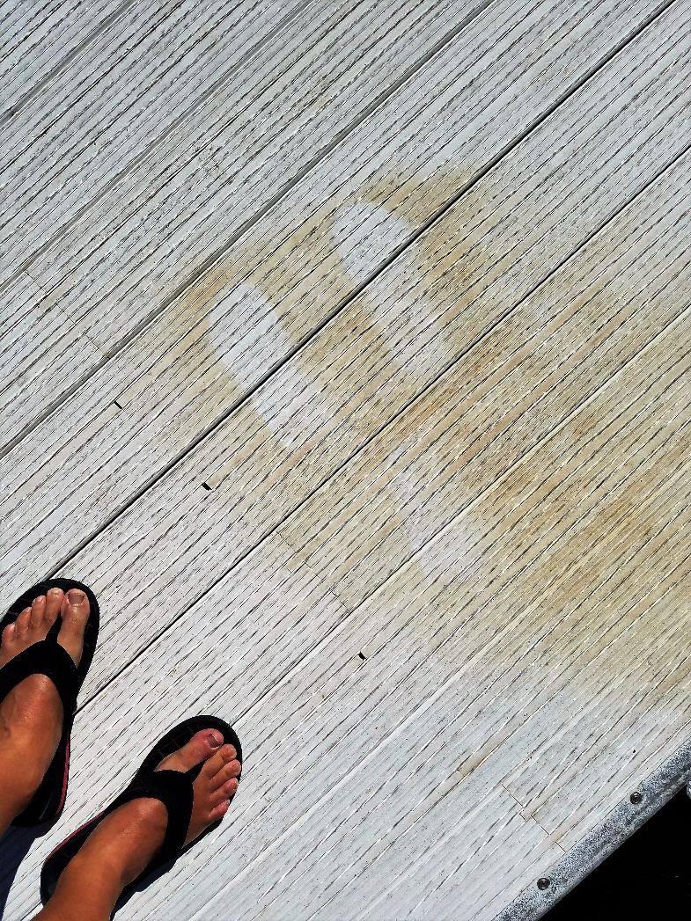
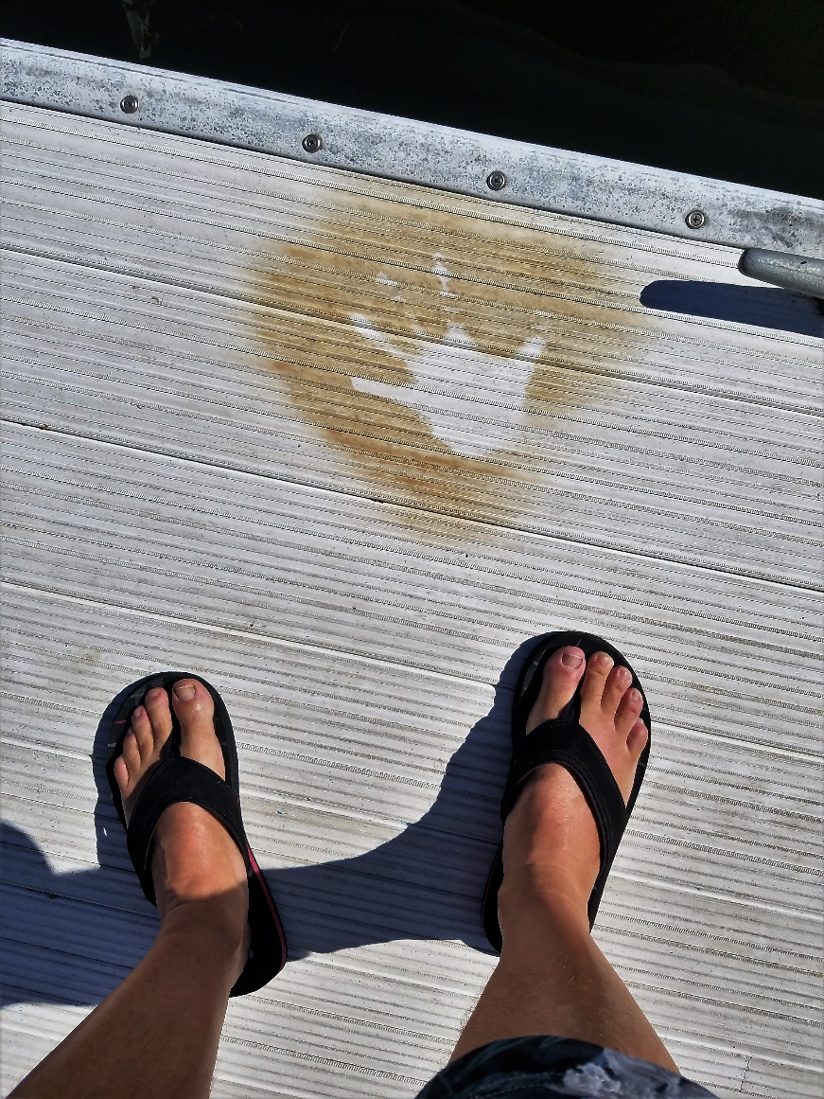
We ALL spent a lot on Money on Upgrading our Marina, please take care of it!

Slide 36
Communication
Annual Private Marina Newsletter
Annual billing lease fees
One or two a Private Marina All Members meetings
Private Marina Oak Shore email - Mailchimp.com
We hoping this is working for each of you and you have the information about the Private Marina that you need!

Slide 37
Questions We Receive During the Past Year
A few things the committee discussed:
  Can you rotate the docks al all can take turns in the water on low level times?
    Cannot do that because when you buy a slide you buy a locations and some locations are more valuable than others
  Still have to pay Annual Fee and dock note floating: Normalizing the Annual Fee by location of your slip
    Some slips cost more to operate, whiles others are nested ( All Owners do not get the same value as others)
  Nesting Schedule: We have predetermined locations and levels when the best times to nest each dock.
    We do use variables: lake level, time of year and release schedule
  Current Slip Sales - $30,000.00
  Do we have a waiting list of people wanting to buy a slip?
    No, the Private Marina does not keep list
    We let people know buyers and seller

Slide 38
Open Comments
To ensure all members get a chance to make comments please keep your comments to a 5 minutes limit
All comments will be documented and follow ups will be performed as necessary
Feedback?

Slide 39
Always Looking for New Committee Members
If anyone is interested please contact one of your committee members

Slide 40
C Dock
M Dock
B Dock
D Dock
A Dock
E Dock

Slide 41
Thank You for Coming!

